Slide 1
Introduction To Programming CEIS110

Slide 2
Introduction
We students explored the fundamental concepts of computer programming. We learned how to write code that can solve complex problems, automate tasks, and interact with users. Programming is an essential skill in today's digital age, and learning to code provides a valuable foundation for a wide range of careers in technology. This course is designed for students who have little or no programming experience and will provide a hands-on introduction to the basics of programming. During this course, we learned about programming concepts such as data types, variables, loops, conditional statements, functions, and more. We will also learn how to write code using one of the most used programming languages, Python. In addition to learning the basics of programming, we also developed problem-solving skills and learn to think creatively about how to solve complex problems. At the end of this course, us students developed the skills necessary to write basic programs that can complete simple tasks and solve problems. This course well-prepared students to continue exploring the world of programming and pursue more advanced programming concepts and techniques.

Slide 3
CEIS110 Module 2
Design and setup

Slide 4
Flowchart
Start
Run a basic Python program
Download weather data to a database.
Include the following processes:
Run a basic python program
Download weather data to a database.
Query the weather data
Extract weather data from database into a comma separated file with python
Cleanse weather data
Use python data analytics modules to develop graphical models
Query the weather data.
Extract weather data from database into a comma separated file with Python.
End
Use Python data analytics modules to develop
Cleanse weather data.

Slide 5
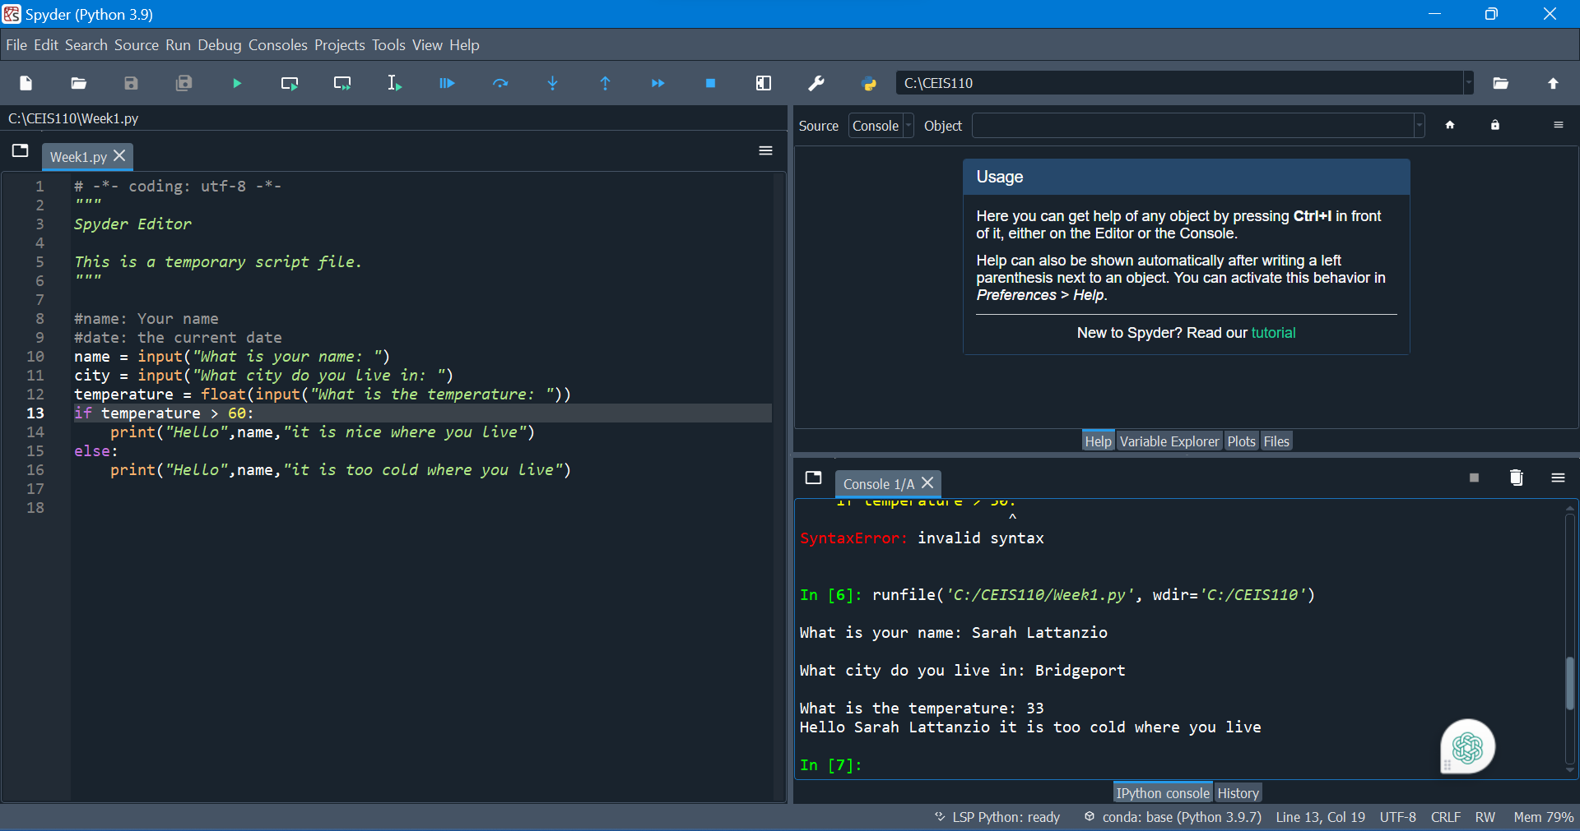
Python program (Screenshot)
Include screenshot of successful python program

Slide 6
Python program (Screenshot)
Include screenshot of successful python program

Slide 7
CEIS110 Module 3
Downloading weather data

Slide 8
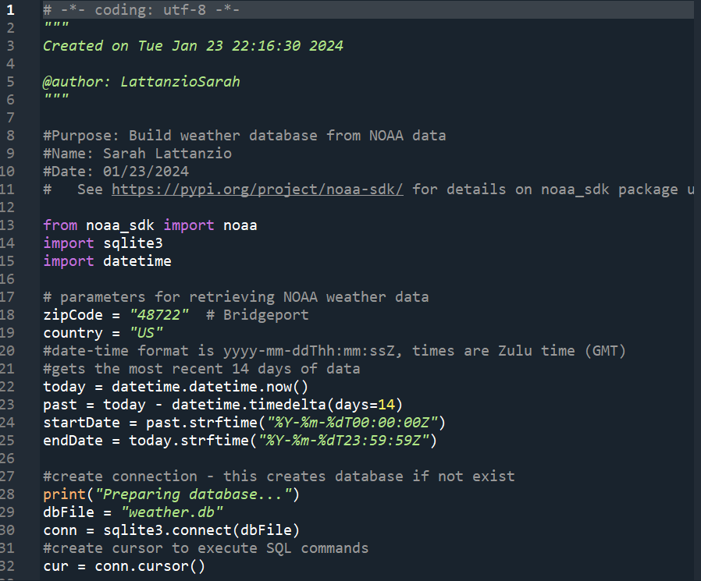
BuildWeatherDb.py Code (Screenshot)
Screenshot of code in Spyder
Must have your name and date in comments
Must have your zip code

Slide 9
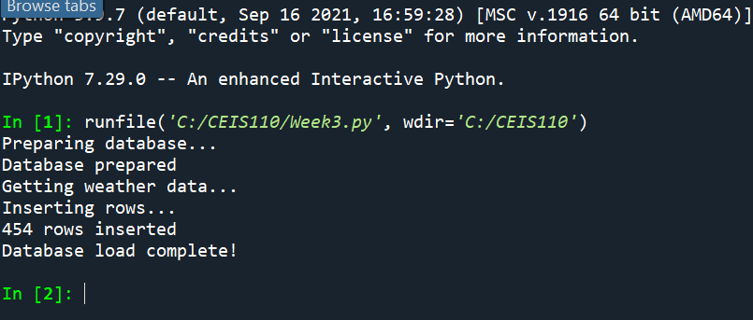
Python Console (Screenshot)
Screenshot of program output in Python console showing program executed successfully

Slide 10
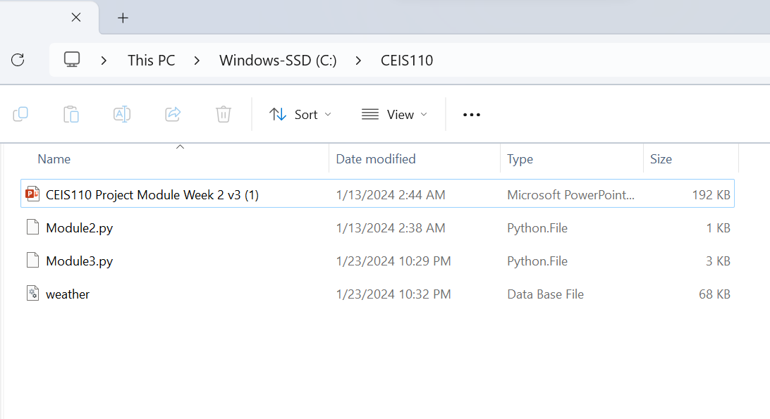
Weather.db File (Screenshot)
Screenshot of Windows Explorer showing database file Weather.db was created

Slide 11
CEIS110 Module 4
Querying the database with SQL

Slide 12
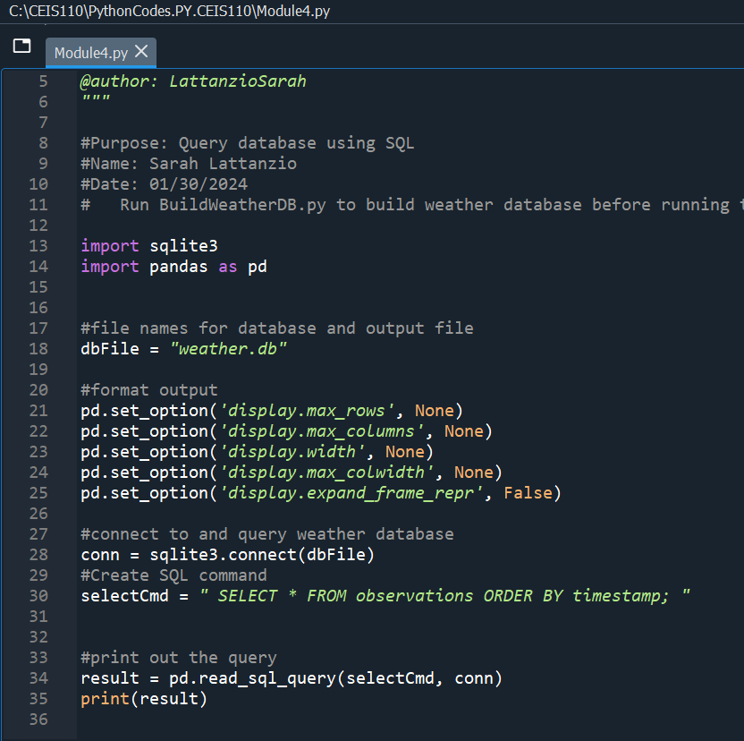
Screenshot of the Python Code (Screenshot)
Screenshot of the top of the code that shows your full name and the date you have been working on the assignment

Slide 13
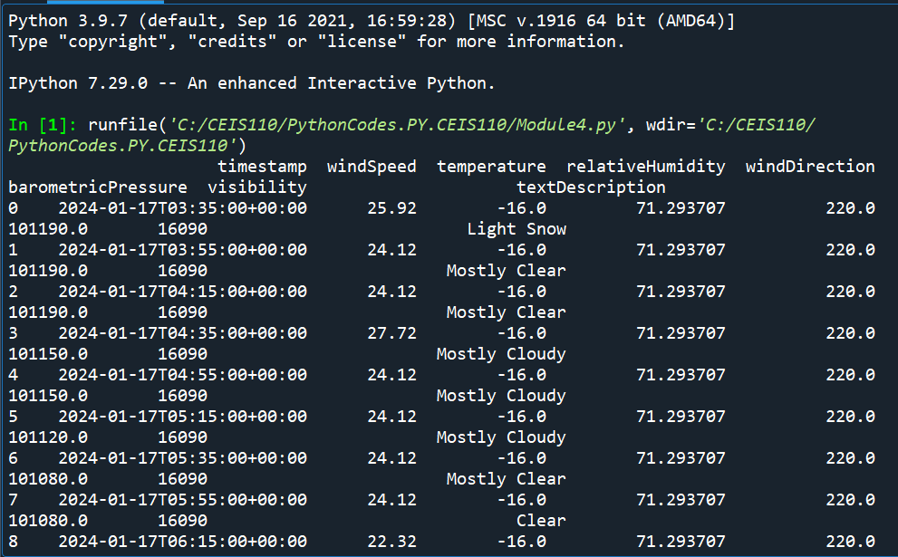
Query to retrieve all columns and all rows (Screenshot)
Screenshot of SQL query command and results

Slide 14
Query to retrieve lowest and highest temperatures (Screenshot)
Screenshot of SQL query command and results

Slide 15
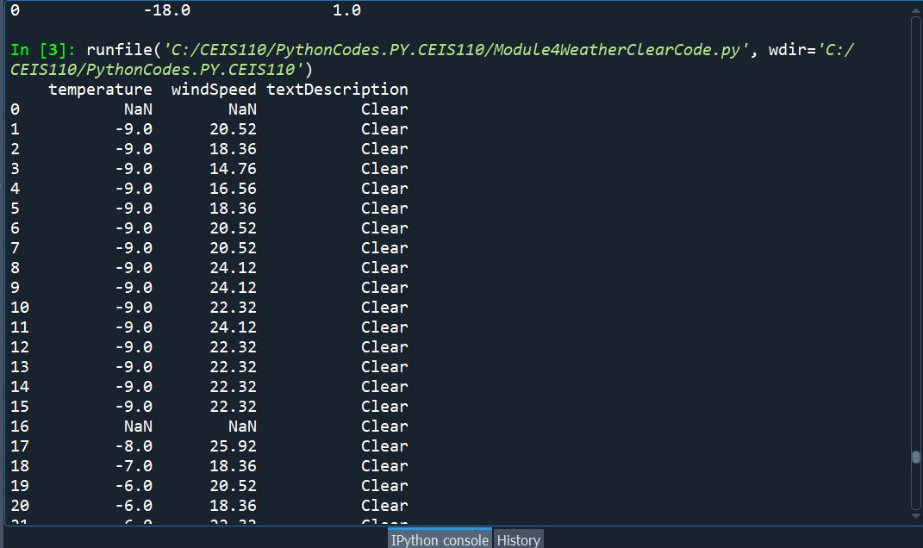
Query to retrieve all clear days (Screenshot)
Screenshot of SQL query command and results

Slide 16
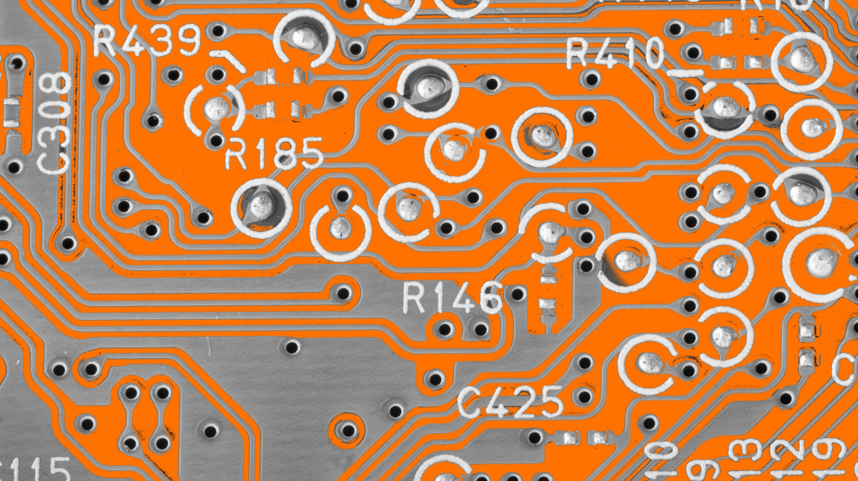
CEIS110 Module 5
Querying and manipulating data with SQL and Python

Slide 17
CEIS110 Module 6
Develop Graphical Models and Interpret Results

Slide 18
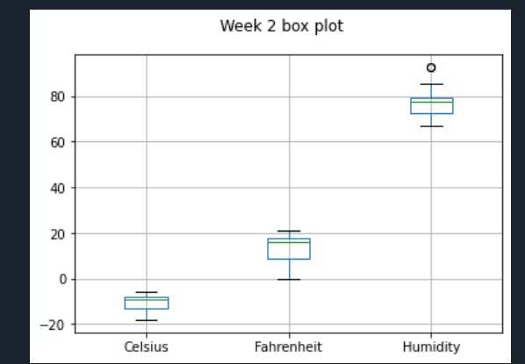
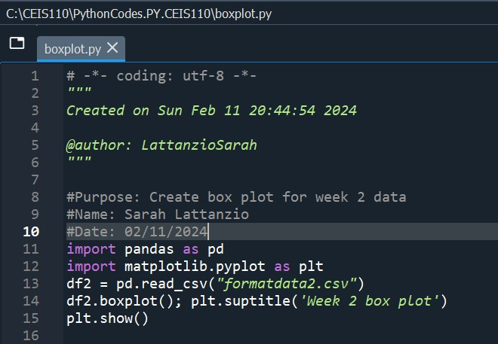
Plot #1
Plot and code used to generate it
Box
Line
Histogram
Scatter
Research your own!

Slide 19
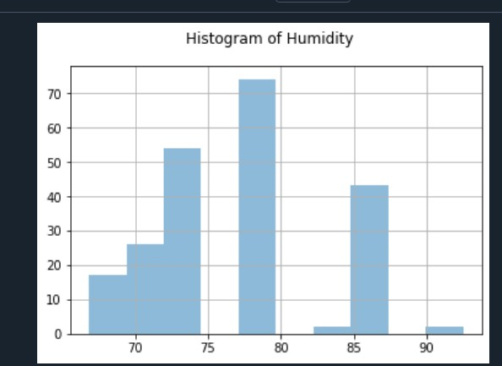
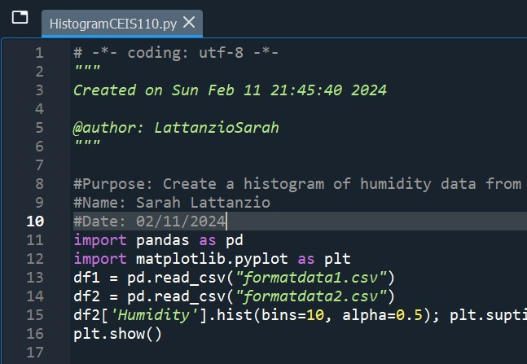
Plot #2 (Screenshots)
Plot and code used to generate it
Box
Line
Histogram
Scatter
Research your own!

Slide 20
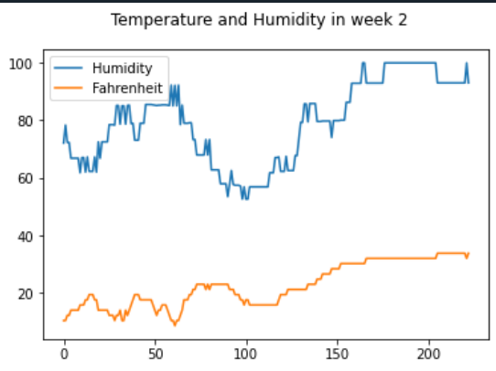
Analysis
Think of your own question and create a chart/graph to answer it
Your own question: How are humidity and temperature related to each other?
Answer supported by Chart: In the first half of week 2 the temperature goes down and humidity goes up. Inverse relationship. Towards the end of week 2 due to unusual weather they both are going up.

Slide 21
Prediction
Develop a prediction based on the data. What variations in temperature and humidity do you expect over the next few hours or days? How would humidity change if temperature goes up or down?
Answer:
From the data from the previous chart, I expect the temperature and humidity will stay in the same range for the next few days.
Usually when the temperature goes up the humidity goes down when the temperature goes down the humidity increases.

Slide 22
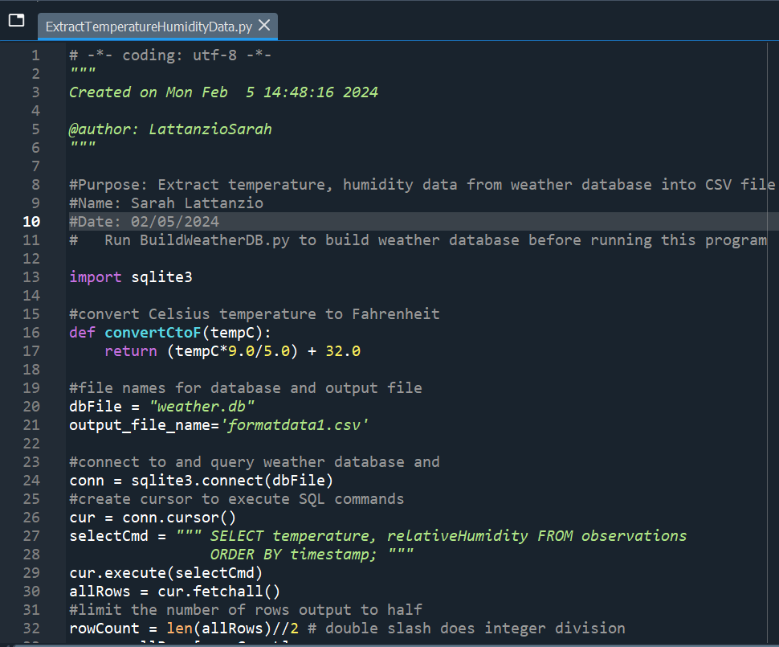
Python code (Screenshot or file)
ExtractTempHumidity.py Python code screenshot with your full name and date in comments at the top of the code that shows you have been working on the assignment

Slide 23
Retrieve and Convert Data to CSV Format (Screenshot)
Formatdata file open in Excel showing 3 columns of data

Slide 24
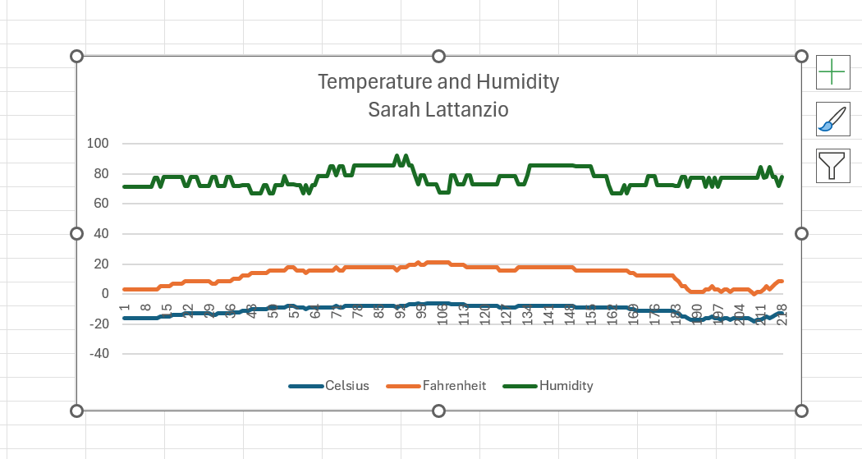
Temperature and Humidity Chart (Graph)
Excel chart based on temperature and humidity data from database

Slide 25
Career Skills
Creating graphs and Charts
Databases and SQL: Learned about databases and SQL, a popular database management language. You will learn how to interact with databases, how to store, retrieve, and manipulate data, and how to build complex queries to extract specific information
Python Language
Security: As a programmer, you must have a thorough understanding of security principles and best practices to ensure that your programs are secure. I learned how to implement encryption, authentication, and other security measures that protect sensitive information and prevent unauthorized access.
Debugging and testing: As a programmer, you inevitably encounter errors and bugs in your code. We learned how to use debugging and testing tools to identify and correct these errors, ensuring that our code is efficient, reliable, and error-free.
Problem-solving skills: Programming is all about solving problems. We learned to think logically and systematically, breaking down complex problems into smaller, manageable pieces. Learned how to use various programming tools to solve problems efficiently.
Collaboration: Programming is often a collaborative process. I learned how to work effectively in a team, ans share code. These skills are essential in a professional programming environment.

Slide 26
Challenges During This Course
Learning a new language: One of the most significant challenges in learning programming is learning a new language. This did get better the more I practiced with it.
Debugging process: Debugging is an essential process in programming, but it can also be frustrating at times. Finding and fixing errors can be a time-consuming process, and it can be challenging to know where to start. The best way I overcome this was breaking the code down into smaller sections, testing each section for errors individually, until you find the root cause of the issue. This one was a big one for me.
Keeping up with the pace: The course may be fast-paced, and it can be challenging to keep up with all the material. One way I overcome this I attended office hours, ask questions, take notes, and keep up with the practice assignments. The more I practiced, the more comfortable I got with the material.

Slide 27
Conclusion
This course has provided me with a solid foundation in essential programming skills and concepts that are vital in today's digital world. I have learned programming language, Python, data structures, algorithms, debugging and testing, and project management, to name a few. I feel now well-equipped to take on more advanced programming challenges and explore different areas of programming. Whether I choose to pursue web development, software engineering, or database management, the fundamental knowledge and skills gained from this course will serve as a strong foundation for my future success. Moreover, as a student I will progress to more advanced programming concepts, I encourage myself everyday to continue practicing, experimenting, and exploring new coding challenges. I will Keep expanding my programming skills by exploring new technologies, attending workshops, and participating in real-world projects to gain practical experience.
Remember that programming is not a solo activity - collaboration and teamwork are essential to success in this field. I will continue to network with peers, colleagues, and mentors in the industry to learn from them, share ideas, and collaborate on projects. In conclusion, Introduction to Programming CEIS110 has equipped you to become an excellent programmer, and the skills you have acquired are an asset. I look forward to seeing the dynamic ways I can learn and will apply my new programming skills in the world. I plan to keep pursuing my passion and strive for excellence. This class has taught much, and Professor Halsey has been a great asset to helping me strive for success in this class and DeVry University has great faculty, students, and a wonderful atmosphere and provide you with all the help and tools needed to succeed.
Thank you all of DeVry and Professor Halsey for taking the time to invest in my success with this project!

