Slide 1
Final Course Project
Operating Systems
Sarah Lattanzio

Slide 2
Introduction
This final project is a compilation of all the work that I have completed as part of CEIS 106- Introduction to Operating Systems.

Slide 3
Linux Filesystem Hierarchy

Slide 4
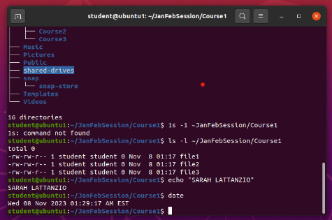
Create directories and files
Take a screenshot of the output in Steps 5 and 6.

Slide 5
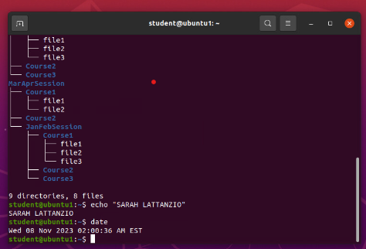
Copy and remove directories and files
Take a screenshot of the output in Step 3.

Slide 6
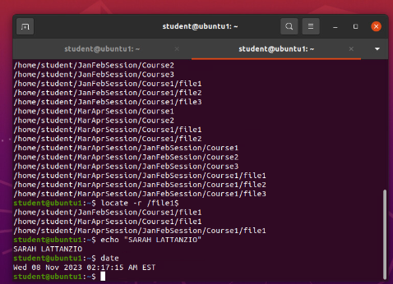
Locate directories and files
Take a screenshot of the output in Steps 5 and 6.

Slide 7
Navigate the Linux filesystem tree
1.) What is the pwd command an acronym for? What about the cd command?
pwd – print working directory - shows the path for the current directory
cd – change directory – change over the directory that you specify
2.) Explain the differences between a relative path and an absolute/full path in Linux.
The difference between absolute path and relative path is how they both are interpreted. Regardless of the present directory, absolute paths direct to the same location, while relative paths can guide to different locations based on the current directory.
Relative Path – path based on your current location
Absolute Path – path starting from the very top of file system, which is the root -- /
References:
1.) Module 2 - Lesson 1: Changing Directories – Link: https://devryu.instructure.com/courses/99700/pages/module-2-lesson-1-changing-directories?module_item_id=12886166
2.) “Difference between absolute path and relative path in linux” – Article Link: https://www.linkedin.com/pulse/difference-between-absolute-path-relative-linux-waqas-muazam/
3.) Module 2 – Project Video

Slide 8
Linux Shell Scripts

Slide 9
Change script file permissions
Take a screenshot of the output in Step 5.

Slide 10
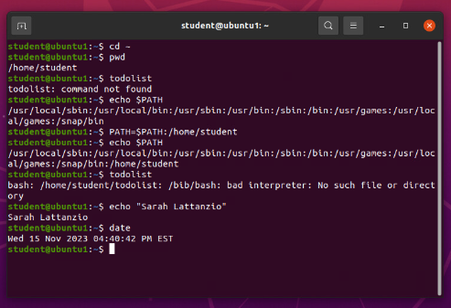
Set the PATH variable
Take a screenshot of the output in Step 6.

Slide 11
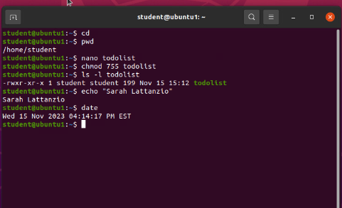
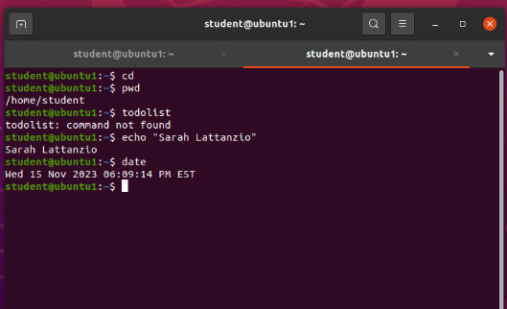
Make the PATH variable permanent
Run the todolist script before and after making the PATH variable permanent. Take a screenshot of both Terminal windows.

Slide 12
Create a shell script
1. What are the file permissions of the script?
Answer here:
rw- rw- r-- -- read/write for the owner, read/write for the group, read only for everyone else
2. What’s the name of the user-defined variable in the script?
Answer here:
text
3. Which redirection meta-character is used in the script? What does it do?
Answer here:
>> -- redirection to the file and appends to the end of the file
References:
1. Project Recording Video – Module 3

Slide 13
User and Group Managment

Slide 14
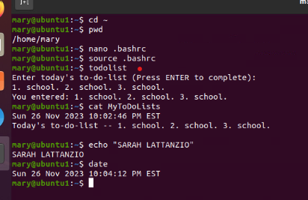
Test user and group settings
Take a screenshot of the output in Step 6.

Slide 15
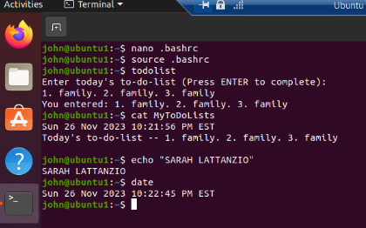
Add users in GUI
Take a screenshot of the output in Step 9.

Slide 16
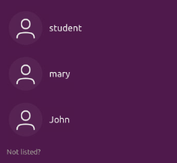
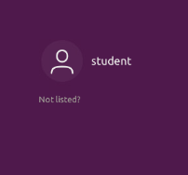
Remove users and groups
Take a screenshot of the log on page with three user accounts.
Take a screenshot of the log on page with only your user account (i.e., student).

Slide 17
Add users and groups in CLI
1. What does the –m option in the useradd command do?
Answer here:
-m -- tells the useradd command to create a home directory for this new user
2. What does the -3 option in the tail command do?
-3 -- tells tail command how many lines to show from the end of the file
3. Which line of the /etc/group file lists members of the “students” group? Copy it here.
References:
1. Module 4 – Project Video

Slide 18
Network Configuration

Slide 19
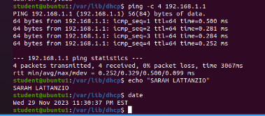
Discover host IP configurations
1. What is the IP address of your Ubuntu machine? Answer here:
192.168.1.107
2. What is the IP address of its default gateway? Answer here:
192.168.1.1
3. What is the IP address of its DHCP server? Answer here:
192.168.1.1
4. What is the IP address of its DNS server? Answer here:
192.168.1.1
Take a screen capture of the output in Step 12.

Slide 20
Manage network interfaces
1. Which DHCP message is shown in the output of the sudo dhclient –v –r eth0 command? [hint: the message name is in uppercase.]
Answer here:
DHCPRELEASE
2. Which four DHCP messages are shown in the output of the sudo dhclient –v eth0 command? [hint: the message names are in uppercase.]
Answer here: DHCPDISCOVER, DHCPOFFER, DHCPREQUEST, DHCPACK
References:
1.) Module 5 – Instruction Video

Slide 21
Use network utilities
Take a screen capture of the output in Step 7 and Step 8.

Slide 22
System Performance Monitoring

Slide 23
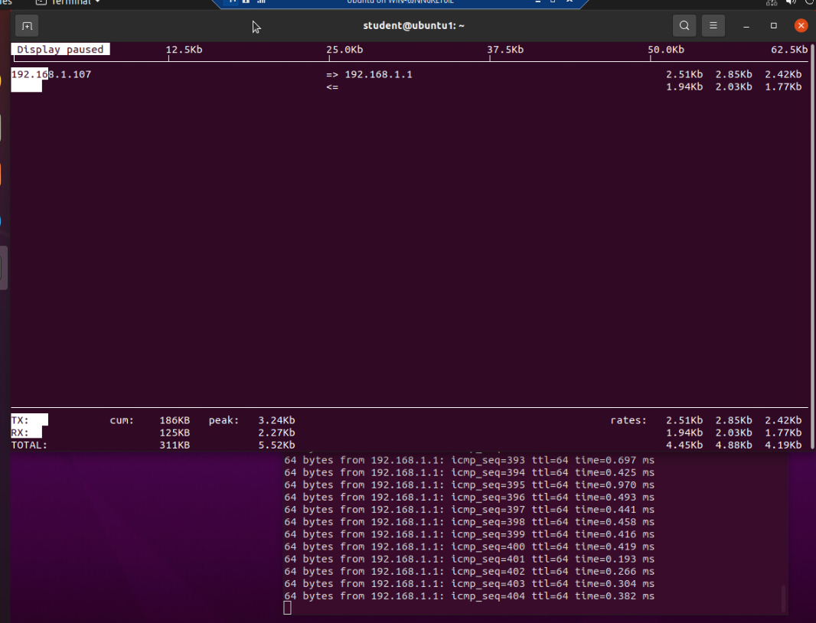
Monitor network bandwidth usage
Take a screenshot of the output in Step 4.

Slide 24
Monitor Linux processes
1. What is the default action of the 15 SIGTERM kill signal?
Answer here: Kill the highlighted process.
2. In the System Monitor window, click on % CPU to sort the processes by CPU load. Which process shows the highest percentage of CPU usage?
Answer here: gnome shell (GUI)
References:
1. Module 6 Video

Slide 25
Monitor user activities
Issue the sudo accton on command to turn on GNC accounting. Run the sudo updatedb command. Enter lastcomm updatedb to check if the updatedb command was executed before. Remember to turn off GNC accounting (sudo accton off) after answering the questions.
1. What flag value is displayed in the output?
Answer here: s --”super user”
2. Why is the name of the user who ran the processes shown as root, not student?
Answer here:
References:
1. Module 6 video

Slide 26
Challenges
Linux is case sensitive compared to Windows.
Learning to navigate the root directory, and the meta characters different usage in the CLI.
Learning the commands and how they can be used for more than one function.
Learning how to navigate/differentiate the vim, nano, and bash.

Slide 27
Career Skills
Creating scripts to automate tasks
Navigating the file system
Setting permissions for the user and files
Hands-on experience using Linux, administrative tasks, and using the CLI
Using the system monitoring tools
Learning common Linux commands
Monitoring network usage

Slide 28
Conslucion
This semester taught me a lot about the Linux operating system. We learned its value to business processes and programmers. I enjoyed learning about Linux, and while at no means am I an expert, I do look forward to using it more effectively in the future.

